Slide 1
Problem solving

Slide 2
Hit and trial
People viewed the phenomena of intelligence as strongly related to problem solving

Slide 3
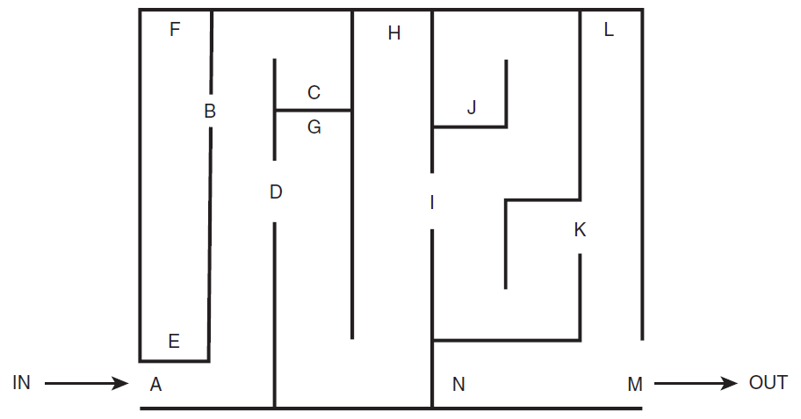
Problems and their Representations
Traversing a Maze

Slide 4
Hit and trial
Toddler is to switch on the light in a dark room
Combinational lock

Slide 5
Conclusion
That different intelligent species use a similar approach to solve the problem at hand.
This approach is essentially the classical way in which intelligent species solve problems. Technically we call this hit and trial approach the “Generate and Test” approach.

Slide 6
Generate and Test
This is a technical name given to the classical way of solving problems
Generate different combinations to solve our problem, and the one which solves the problem is taken as the correct solution

Slide 7
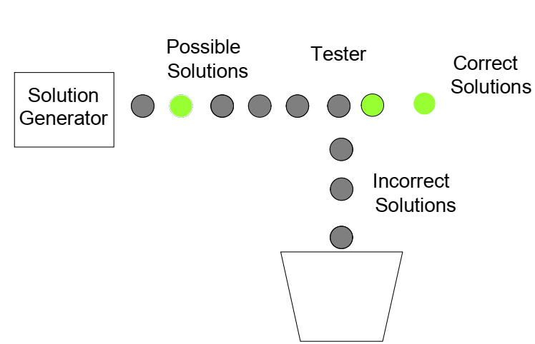

Slide 8
Problem Representation
All the problems that we have seen till now were trivial in nature
Addition of parameters
The key to problem solving is actually good representation of a problem.
Natural representation of problems is usually done using graphics and diagrams to develop a clear picture of the problem in your mind.

Slide 9
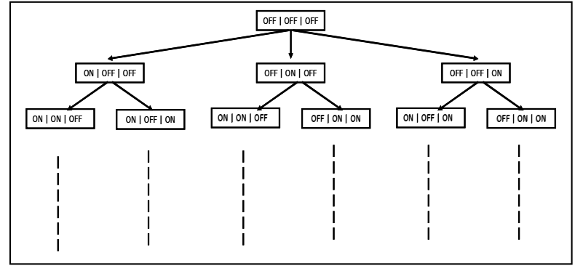


Slide 10
Problems and their Representations
Three men and three lions are on one side of a river, with a boat. They all want to get to the other side of the river. The boat can only hold one or two at a time. At no time should there be more lions than men on either side of the river, as this would probably result in the men being eaten.
Representation could be 3, 3, 1 0, 0, 0

Slide 11
Take one lion and leave it on the other side.
  On the other side: 1 lion, 0 men; On the starting side: 2 lions, 3 men.
Go back alone to the starting side.
  On the other side: 1 lion, 0 men; On the starting side: 2 lions, 2 men.
Take two men and bring them to the other side.
  On the other side: 1 lion, 2 men; On the starting side: 2 lions, 0 men.
Leave one man on the other side, but take the other man and return to the starting side.
  On the other side: 1 lion, 1 man; On the starting side: 2 lions, 1 man.
Take two lions and bring them to the other side.
  On the other side: 3 lions, 1 man; On the starting side: 0 lions, 1 man.

Slide 12
Go back alone to the starting side.
  On the other side: 3 lions, 1 man; On the starting side: 0 lions, 2 men.
Finally, take two men and bring them to the other side.
  On the other side: 3 lions, 3 men; On the starting side: 0 lions, 0 men.
  Now, everyone is safely on the other side of the river!

Slide 13
Components of Problem Solving
Problem Solution
Goal State or the state that represents the solution of the problem

Slide 14
“operators”.
In case of the mouse example, turn left, turn right, go straight are the operators which help us travel inside the solution space.
In short the action that takes us from one state to the other is referred to as an operator.
So while solving a problem we should clearly know that what are the operators that we can use in order to reach the goal state from the starting state. The sequence of these operators is actually the solution to our problem.

Slide 15
So while solving a problem we should clearly know that what are the operators that we can use in order to reach the goal state from the starting state.
The sequence of these operators is actually the solution to our problem.

Slide 16
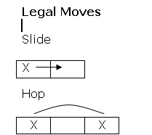
Two – One Problem
Start
Goal
1
1 ? 2 2
2
2 ? 1 1
Legal Moves:
Slide
Hop
Rules:
1s’ move right
2s’ move left
Only one move at a time
No backing up

Slide 17
Two – One Problem
Trials to solve the problem
Trial One
Trial Two
1
1 ? 2 2
1
1 ? 2 2
1
1 2 ? 2
1
? 1 2 2
1
? 2 1 2
?
1 1 2 2
1
2 ? 1 2
Stuck!!!
1
2 2 1 ?
1
2 2 ? 1
Stuck!!!

Slide 18
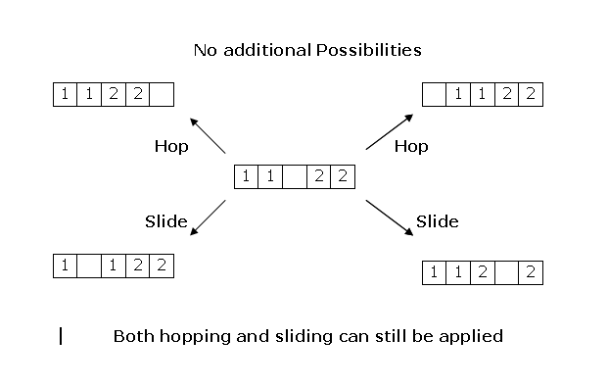
Two – One Problem
Five States

Slide 19
Two – One Problem
Solution Space
H
H
?
1 1 2 2
1 1
?
2 2
1 1 2 2
?
S
S
1
?
1 2 2
1 1 2
?
2
S
H
H
S
? 1 1 2 2
1 2 1
?
2
1
?
2 1 2
1 1 2 2
?
S
S
S
S
1 2 1 2
?
1 2
?
1 2
?
1 2 1 2
H
H
H
H
1 2
?
2 1
?
2 1 1 2
1 2 2 1
?
2 1
?
1 2
S
H
S
S
H
S
1 2 2
?
1
?
2 1 2 1
2
?
1 1 2
1 2 2
?
1
2 1 1 2
?
2
?
1 1 2
S
S
2
?
1 2 1
2 1 2
?
1
H
H
2 2 1
?
1
2
?
2 1 1
S
S
2 2
?
1 1

Slide 20
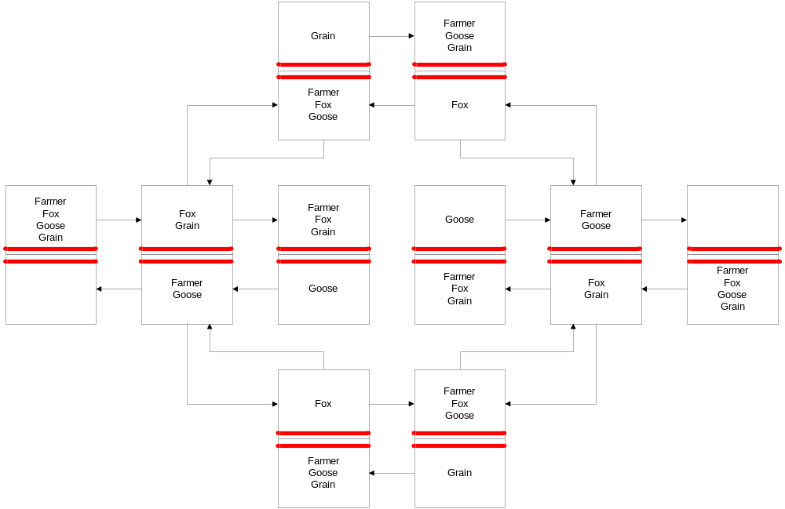
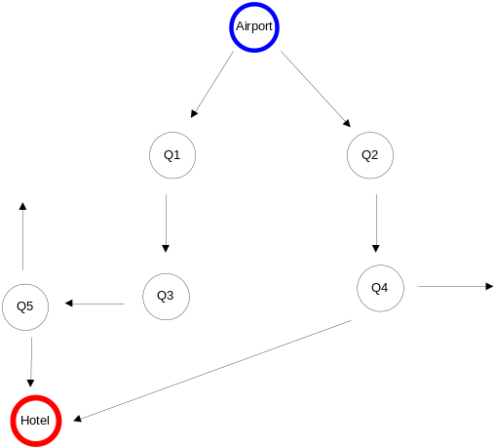
Solution to Problem Solving : Searching
?
1 1 2 2
H
1 1
?
2 2
H
1 1 2 2
?
S
S
1
?
1 2 2
1 1 2
?
2
S
H
H
S
? 1 1 2 2
1 2 1
?
2
1
?
2 1 2
1 1 2 2
?
S
S
S
S
1 2 1 2
?
1 2
?
1 2
?
1 2 1 2
H
H
H
H
1 2
?
2 1
?
2 1 1 2
1 2 2 1
?
2 1
?
1 2
S
H
S
S
H
S
1 2 2
?
1
?
2 1 2 1
2
?
1 1 2
1 2 2
?
1
2 1 1 2
?
2
?
1 1 2
S
S
2
?
1 2 1
2 1 2
?
1
2 2 1
H
?
1
2
?
H
2 1 1
S
S
2 2
?
1 1

Slide 22
Tree and Graph Terminology
A
B
C
D
E
F
G
H
“A” is the “root node”
“A, B, C …. J” are “nodes”
“B” is a “child” of “A”
“A” is ancestor of “D”
“D” is a descendant of “A”
“D, E, F, G, I, J” are “leaf nodes”
Arrows represent “edges” or “links”
I
J

Slide 23
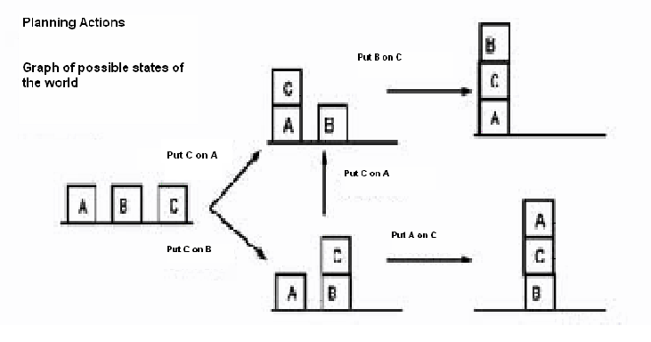
Examples of Graphs
Notes:
However, graphs can also be much more abstract. Think of the graph defined as
follows: the nodes denote descriptions of a state of the world, e.g. which blocks are
on top of what in a blocks scene, and where the links represent actions that change
from one state to the other.
A path through such a graph (from a start node to a goal node) is a "plan of action"
to achieve some desired goal state from some known starting state. It is this type of
graph that is of more general interest in AI.

Slide 24
Problem Formulation using Graphs
The search methods we’ll be dealing with are defined on trees and graphs
A
3
B
3
C
2
S
4
4
G
3
2
D
1
E
3
F
Notes:
Comment on it from Winston Figure 4.1

Slide 25
Tree Search
Graph search is really tree search
S
A
3
3
2
B
C
A
D
B
D
A
E
4
4
G
S
C
E
E
B
B
F
3
D
E
F
2
D
F
B
F
C
E
A
C
G
1
3
G
C
G
F
G

